Slide 1

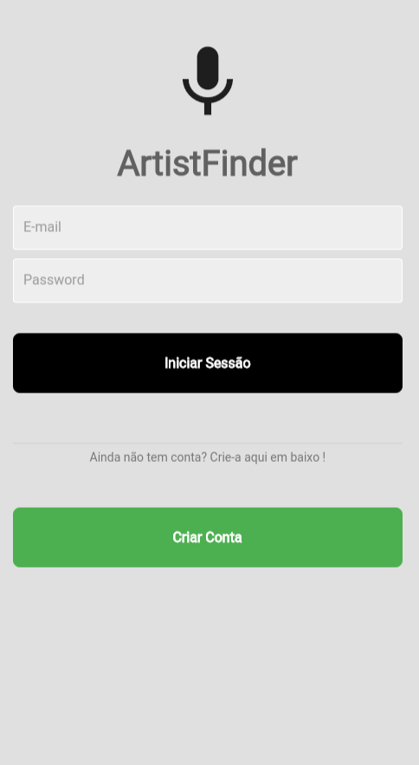
IHC - Assignment 2
25 May 2023
ARTIST FINDER
Final presentation and Demo
Filipe Barbosa - 103064
Miguel Gomes - 103826
Rafael Pinto - 103379
Class P2
1

Slide 2
INTRODUCTION
Artist Finder
Contextualization: Artist Finder is a mobile app where it's possible for erveryone to book a local artist for an event or party.
Motivation: We know some local artists and the struggles that they face earning money in the art sector, but we noticed too that the local cafes/bars managers don't know where to find this artists, so this app helps filling this gap in the market.
2

Slide 3






PROJECT OBJECTIVES
Artist Finder
Goals
Offer a large variety of artists types
Help artists reach new people
Benefits
Find various unkown artists
Make the negotation process more easier
3

Slide 4
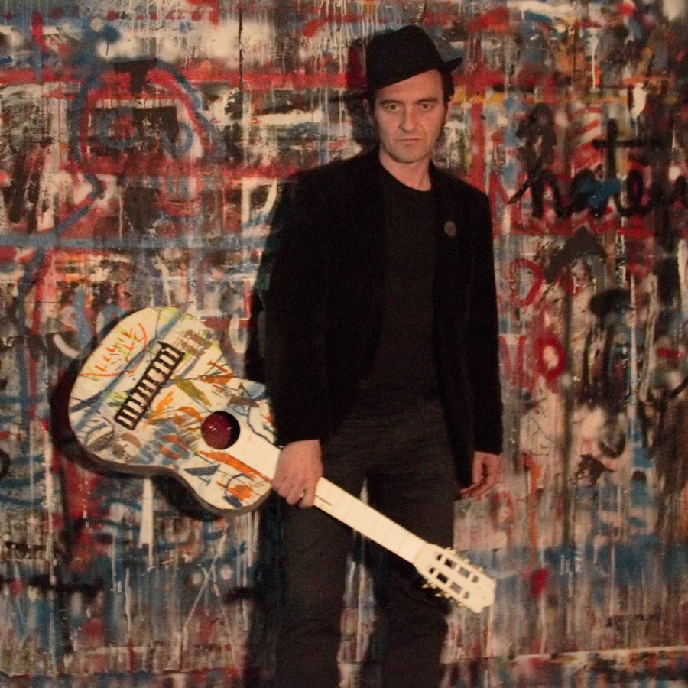
PERSONAS
Name: Pedro Piaf
Age: 52
Job: Musician
Background: Pedro has always performed in small local events, local cafes and bars. He is quite well known in his city.
Problem: He has never managed to expand his popularity and he is stuck in performing at the same places.
Goal: Find new places to perform.
Needs: A place where he can advertise himself.
4

Slide 5
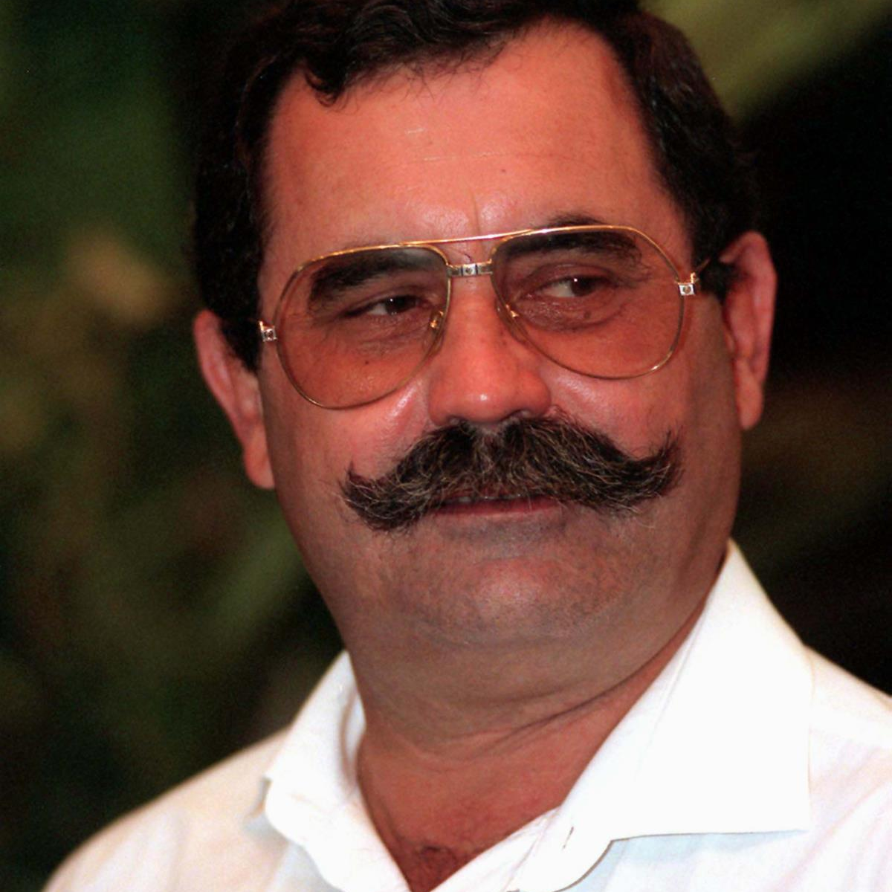
PERSONAS
Name: António Silva
Age: 62
Job: Owner of "O Tono" cafe
Background: António's cafe plays portuguese traditional music all day, everyday, and sometimes on the weekend he invites artists who are his friends to perform live in his cafe.
Problem: He is unable to find new potential costumers because the artists invited to perform in his cafe are always the same
Goal: Find new artists to perform in his cafe.
Needs: A place where he can find new artists.
5

Slide 6


USAGE SCENARIOS
O Tono
Pedro Piaf
António Silva wants to create a different music style night on Saturdays for his café.
Pedro is always performing in his hometown (Fiães), playing in almost all the cafes in the area, and he wants to expand his image to other locations in Portugal
6

Slide 7
MAIN TASKS
1: Search for artist
2: Make a proposal
3: Negotiate the proposal
4: Make a Review
You can search for an artist by type of art and style (ex: singer and rock)
The contractor can make a proposal for an artist for a specific day, time and fee
The artist can make a counter-proposal, reject and accept
The contractor can review the artist after he/she performs a show
7

Slide 8
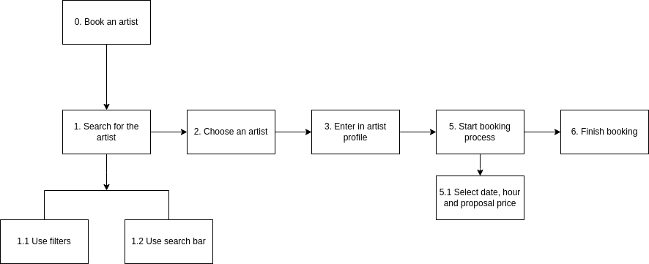
TASK ANALYSIS
HTA
Book an artist
8

Slide 9
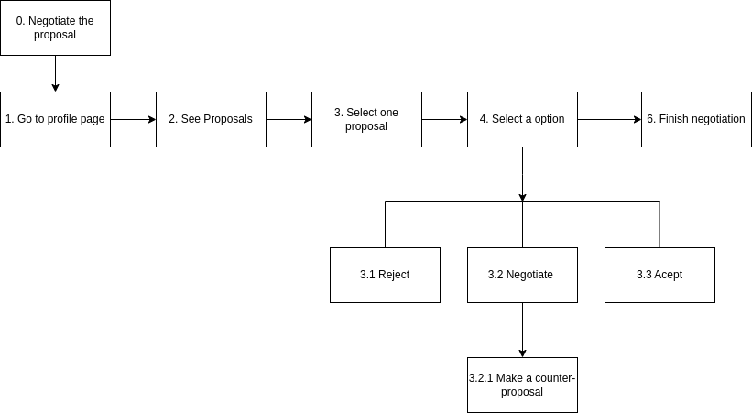
TASK ANALYSIS
HTA
Negotiate the proposal
9

Slide 10
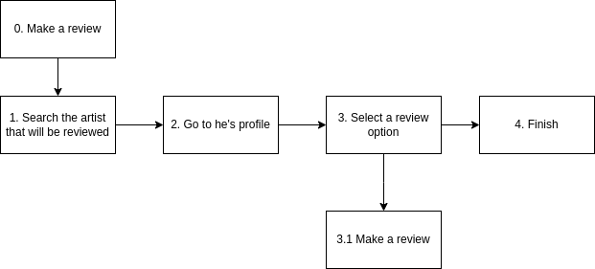
TASK ANALYSIS
HTA
Review an artist
10

Slide 11
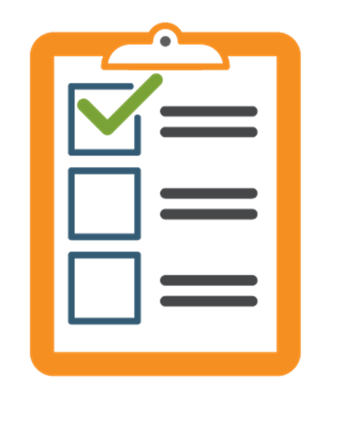
REQUIREMENTS
NON-FUNCTIONAL
FUNCTIONAL
Intuitive interface
Responsive interface
User must be connected to the internet
User must login to navigate the app
Hire artists to perform at an event
Search for a specific type/style of artist
Users can negotiate a certain offer
Event scheduling
11

Slide 12
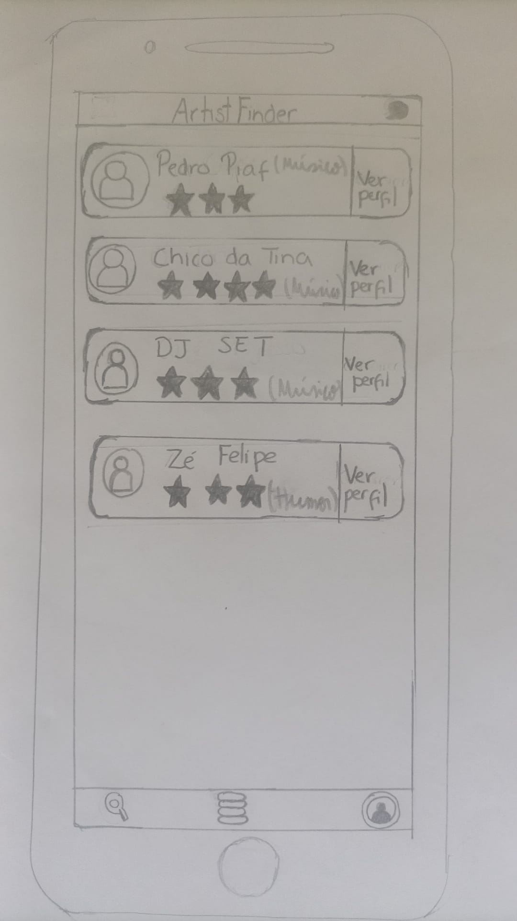
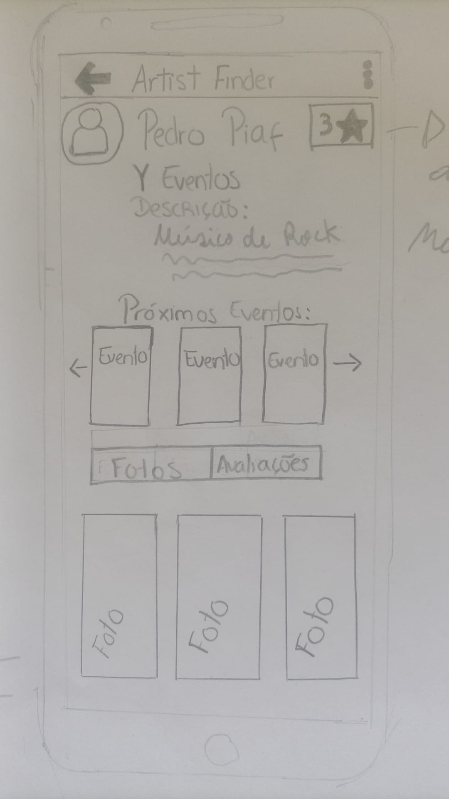
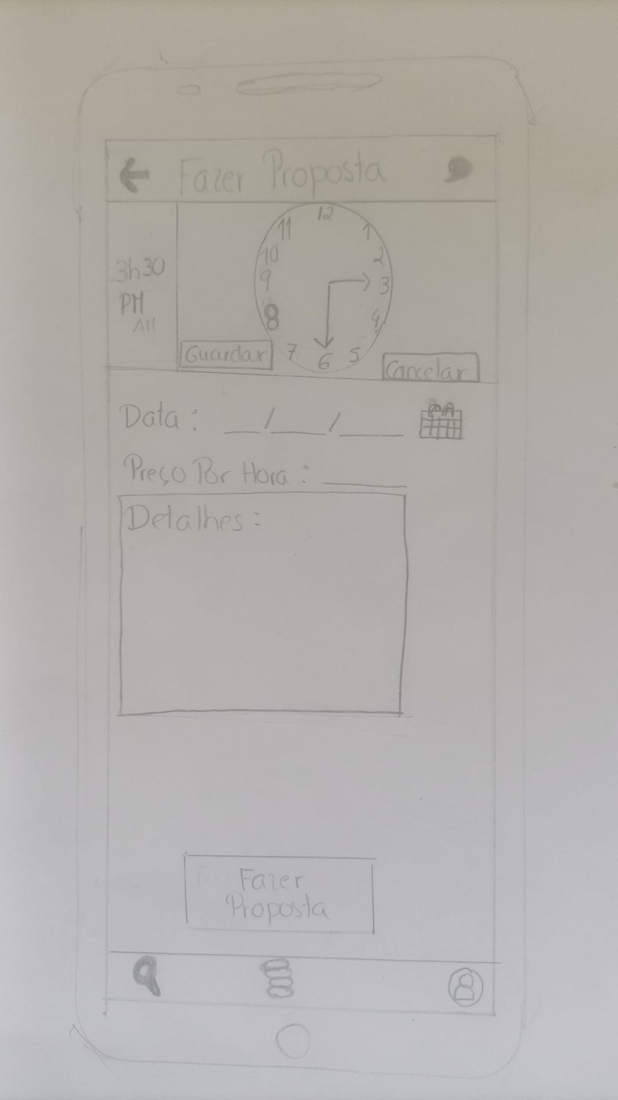
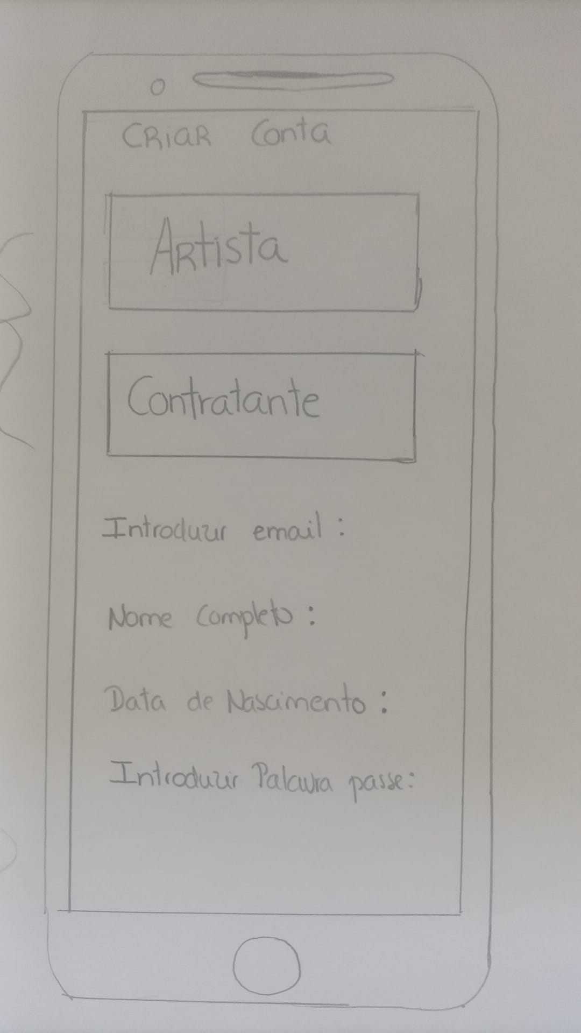
LOW FIDELITY PROTOTYPE (LFP)
12

Slide 13






LFP USER EVALUATION
Participants and Scenarios
7 Participants
2 Scenarios
Methods
Paper protoype
4 Tasks each scenario
13

Slide 14
LFP USER EVALUATION
RESULTS
On the account creation page, have the option to be an artist or a contractor side by side.
On the proposal submission page, include a field to enter the duration of the performance and add a digital clock.
14

Slide 15


PLATFORMS AND TECHNOLOGIES
FRONTEND
BACKEND
15

Slide 16
USER EVALUATION OF THE FUNCTIONAL PROTOTYPE
METHODS
Development of functional prototype according to LFP
Improve flaws pointed out by the previous tests
System Usability Tests
16

Slide 17
USER EVALUATION OF THE FUNCTIONAL PROTOTYPE
PARTICIPANTS
TASKS
6 students
Aged around 20 years old
Search for artist
Make a proposal
Negotiate the proposal
Make a review
17

Slide 18
USER EVALUATION OF THE FUNCTIONAL PROTOTYPE
Usability Tests Results
We concluded that the tasks that presented the greatest difficulty were the negotiation and the search.
Solutions:
Create a button in the bottom navbar that takes the user to his negotiations.
Move the search button to a more visible place.
Difficulty
Tasks
18

Slide 19
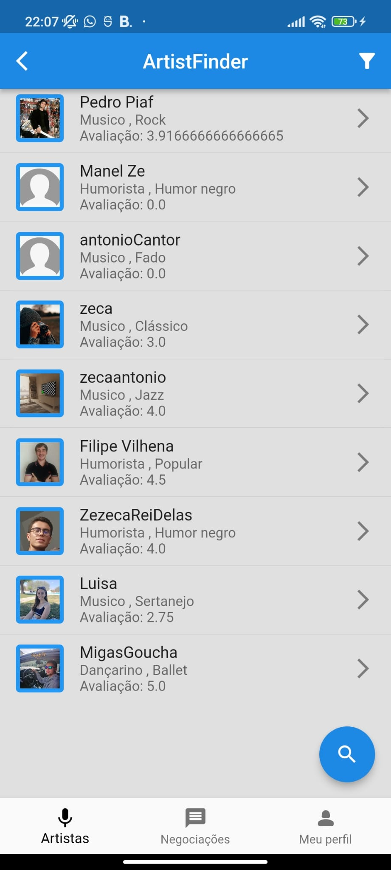
DEMO
MAIN FEATURES
Search for artists
Negotiation between users
Hire artists to perform at an event
Event scheduling
19

Slide 20

FUTURE WORK
Improve the negotiations features
Add images/videos to a certain event
Add location filter
Create a notification system
MEMBER EFFORT
The project was equally distributed between the 3 members of the group.
20

